Slide 1
Machine Learning Basics on Linear Factor Models 2. Setup and Linear Models
This slide set is largely based on Gu, Kelly, and Xiu (2020) and its Internet Appendix.

Slide 2
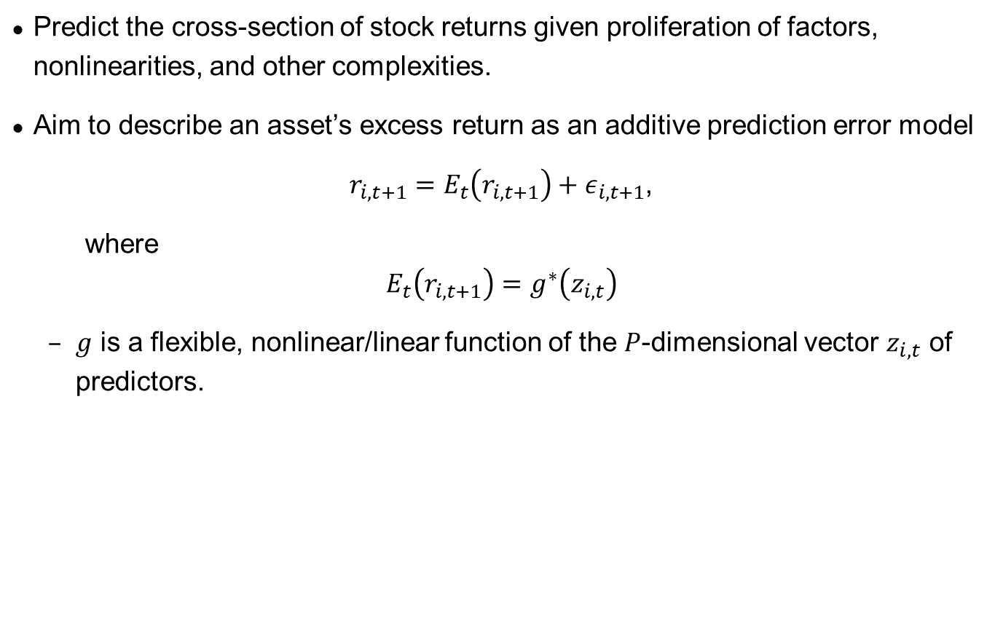
Objective
Predict the cross-section of stock returns given proliferation of factors, nonlinearities, and other complexities.
Aim to describe an asset’s excess return as an additive prediction error model
$r_{i,t+1}=E_{t}\left(r_{i,t+1}\right)+ε_{i,t+1}$,
where
$$E_{t}\left(r_{i,t+1}\right)=g^{∗}\left(z_{i,t}\right)$$
$g$ is a flexible, nonlinear/linear function of the $P$-dimensional vector $z_{i,t}$ of predictors.

Slide 3
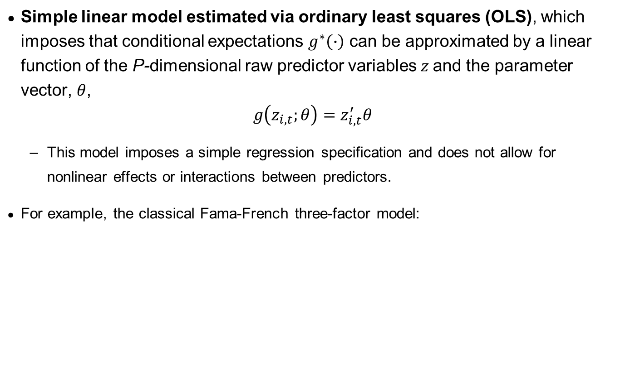
Linear regression (baseline model)
Simple linear model estimated via ordinary least squares (OLS), which imposes that conditional expectations $g^{∗}\left(∙\right)$ can be approximated by a linear function of the P-dimensional raw predictor variables $z$and the parameter vector, $θ$,
$$g\left(z_{i,t};θ\right)=z_{i,t}^{′}θ$$
This model imposes a simple regression specification and does not allow for nonlinear effects or interactions between predictors.
For example, the classical Fama-French three-factor model:

Slide 4

Linear regression (baseline model)
Baseline estimation of the simple linear model uses a standard least squares, or “$l_{2}$”, objective function:
$$ℒ\left(θ\right)=\frac{1}{NT}\sum_{i=1}^{N}{\sum_{t=1}^{T}{{\left(r_{i,t+1}−g\left(z_{i,t};θ\right)\right)}^{2}}}$$
Minimizing $ℒ\left(θ\right)$ yields the pooled OLS estimator
Cons = many predictors

Slide 5
In-Sample and Out-of-Sample (OOS)
Rule of Learning: Learn, and then apply.
Return prediction: learn the “rules” if any, and apply.
Bailey et al. (2014): With regards to the measured performance of a backtested strategy, we have to distinguish between two very different readings: in-sample (IS) and out-of-sample (OOS). The IS performance is the one simulated over the sample used in the design of the strategy (also known as "learning period" or "training set" in the machine learning literature). The OOS performance is simulated over a sample not used in the design of the strategy (a.k.a. "testing set"). A backtest is realistic when the IS performance is consistent with the OOS performance.

Slide 6
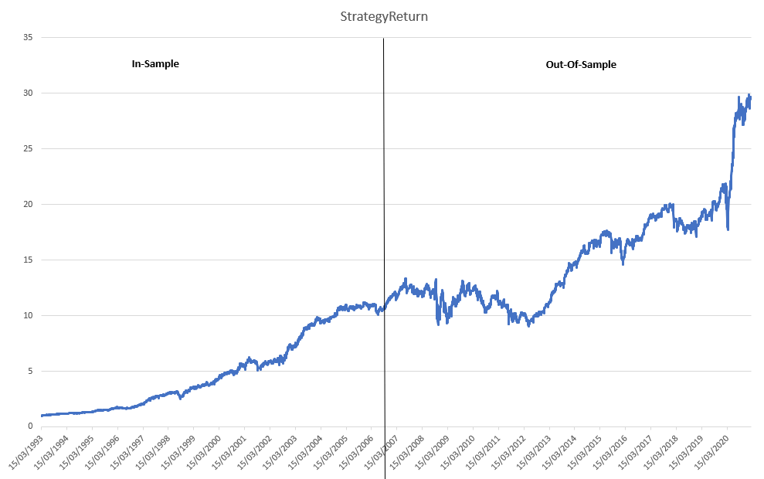
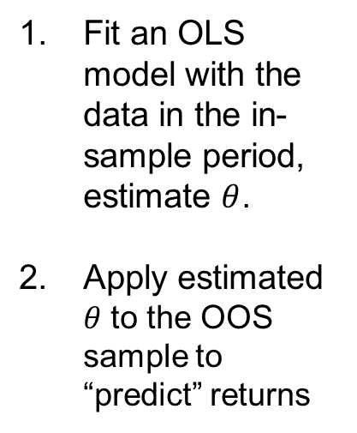
Example
Fit an OLS model with the data in the in-sample period, estimate $θ$.
Apply estimated $θ$ to the OOS sample to “predict” returns

Slide 7
Shrinkage and regularization methods in regression analysis
Simple linear models are bound to fail in the presence of many predictors and it begins to overfit rather than extracting signal (especially a problem with notoriously low signal-to-noise ratio)
Also suffer from instability especially if there is multicollinearity in the model
Crucial to avoiding overfit is reducing the number of estimated parameters and the most common machine learning device for imposing parameter parsimony is to append a penalty to the objective function
Shrinkage or penalized methods constrain the parameter estimates by reducing the variance albeit at the minor cost of increased bias (it can deteriorate a model’s in-sample performance as it aims to improve its stability out-of-sample). Shrinkage means that the coefficients are reduced towards zero compared to the OLS parameter estimates. This is called regularization.
Since the lowest possible estimate for a coefficient is zero, some of the regularization models may be used for parameter selection
Efron B, Morris C. Data analysis using Stein’s estimator and its generalisation. J. Am. Stat. Assoc. 1975;70:311–319. https://www.statisticshowto.com/shrinkage-estimator/ Bühlmann, P.; Van De Geer, S. (2011). “Statistics for High-Dimensional Data“. Springer Series in Statistics. https://www.statisticshowto.com/regularization/. Regularization and Shrinkage.

Slide 8
Shrinkage and regularization methods in regression analysis
Regularization is a way to avoid overfitting by penalizing high-valued regression coefficients
In simple terms, it reduces parameters and shrinks (simplifies) the model. This more streamlined, more parsimonious model will likely perform better at predictions
Regularization adds penalties to more complex models and then sorts potential models from least overfit to greatest
The model with the lowest “overfitting” score is usually the best choice for predictive power
Efron B, Morris C. Data analysis using Stein’s estimator and its generalisation. J. Am. Stat. Assoc. 1975;70:311–319. https://www.statisticshowto.com/shrinkage-estimator/ Bühlmann, P.; Van De Geer, S. (2011). “Statistics for High-Dimensional Data“. Springer Series in Statistics. https://www.statisticshowto.com/regularization/. Regularization and Shrinkage.

Slide 9

Linear prediction with shrinkage / regularization
Linear prediction with regularization / shrinkage is useful when simple linear model fails and begins to overfit rather than extracting signal (e.g., when the number of predictors approaches the number of observations)
Penalized methods differ by appending a penalty to the original loss function:
$$ℒ\left(θ;∙\right)=ℒ\left(θ\right)+φ\left(θ;∙\right)$$
Loss function
Penalty
Efron B, Morris C. Data analysis using Stein’s estimator and its generalisation. J. Am. Stat. Assoc. 1975;70:311–319. https://www.statisticshowto.com/shrinkage-estimator/ Bühlmann, P.; Van De Geer, S. (2011). “Statistics for High-Dimensional Data“. Springer Series in Statistics. https://www.statisticshowto.com/regularization/. Regularization and Shrinkage.

Slide 10
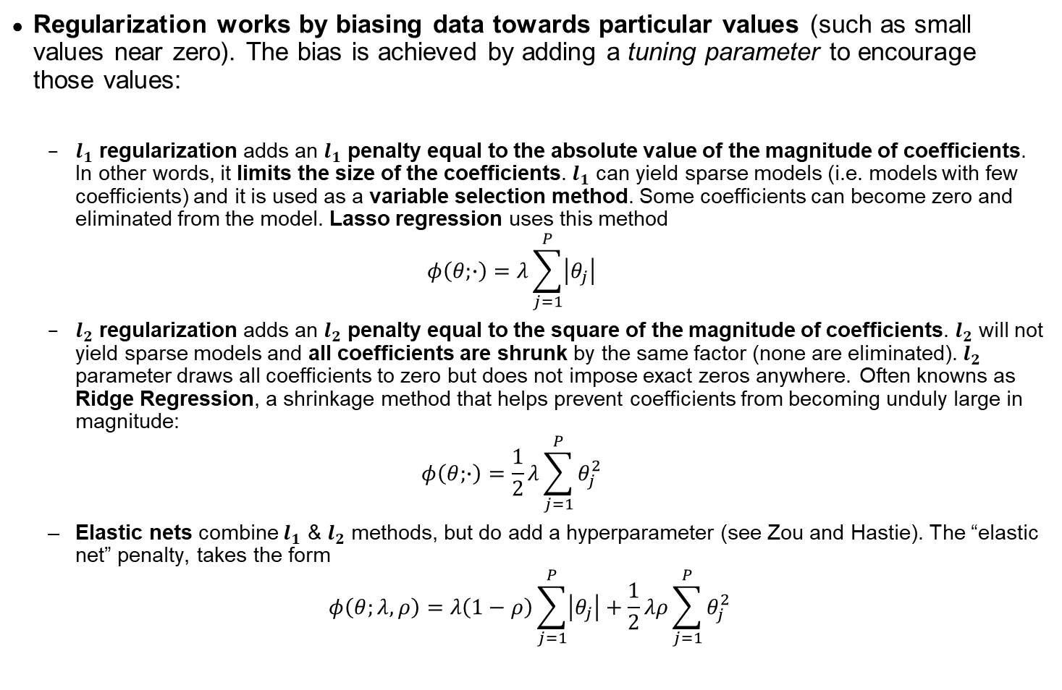
Linear prediction with shrinkage / regularization
Regularization works by biasing data towards particular values (such as small values near zero). The bias is achieved by adding a tuning parameter to encourage those values:
$l_{1}$ regularization adds an $l_{1}$ penalty equal to the absolute value of the magnitude of coefficients. In other words, it limits the size of the coefficients. $l_{1}$ can yield sparse models (i.e. models with few coefficients) and it is used as a variable selection method. Some coefficients can become zero and eliminated from the model. Lasso regression uses this method
$$φ\left(θ;∙\right)=λ\sum_{j=1}^{P}{\left|θ_{j}\right|}$$
$l_{2}$ regularization adds an $l_{2}$ penalty equal to the square of the magnitude of coefficients. $l_{2}$ will not yield sparse models and all coefficients are shrunk by the same factor (none are eliminated). $l_{2}$ parameter draws all coefficients to zero but does not impose exact zeros anywhere. Often knowns as Ridge Regression, a shrinkage method that helps prevent coefficients from becoming unduly large in magnitude:
$$φ\left(θ;∙\right)=\frac{1}{2}λ\sum_{j=1}^{P}{θ_{j}^{2}}$$
Elastic nets combine $l_{1}$ & $l_{2}$ methods, but do add a hyperparameter (see Zou and Hastie). The “elastic net” penalty, takes the form
$$φ\left(θ;λ,ρ\right)=λ\left(1−ρ\right)\sum_{j=1}^{P}{\left|θ_{j}\right|}+\frac{1}{2}λρ\sum_{j=1}^{P}{θ_{j}^{2}}$$
Efron B, Morris C. Data analysis using Stein’s estimator and its generalisation. J. Am. Stat. Assoc. 1975;70:311–319. https://www.statisticshowto.com/shrinkage-estimator/ Bühlmann, P.; Van De Geer, S. (2011). “Statistics for High-Dimensional Data“. Springer Series in Statistics. https://www.statisticshowto.com/regularization/. Regularization and Shrinkage.

Slide 11
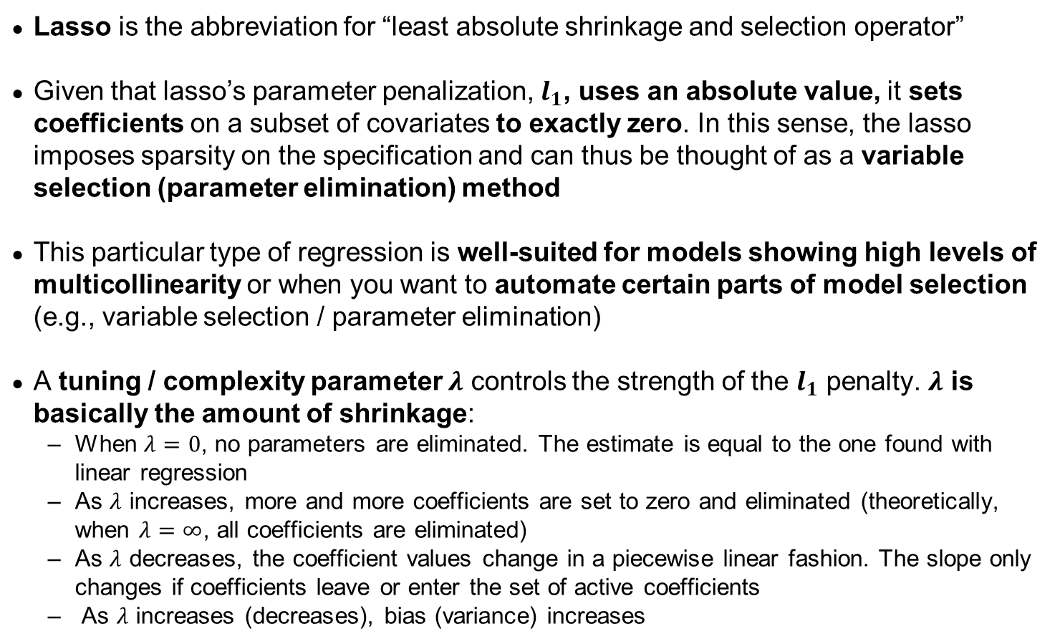
Lasso regression
Lasso is the abbreviation for “least absolute shrinkage and selection operator”
Given that lasso’s parameter penalization, $l_{1}$, uses an absolute value, it sets coefficients on a subset of covariates to exactly zero. In this sense, the lasso imposes sparsity on the specification and can thus be thought of as a variable selection (parameter elimination) method
This particular type of regression is well-suited for models showing high levels of multicollinearity or when you want to automate certain parts of model selection (e.g., variable selection / parameter elimination)
A tuning / complexity parameter $λ$ controls the strength of the $l_{1}$ penalty. $λ$ is basically the amount of shrinkage:
When $λ=0$, no parameters are eliminated. The estimate is equal to the one found with linear regression
As $λ$ increases, more and more coefficients are set to zero and eliminated (theoretically, when $λ=∞$, all coefficients are eliminated)
As $λ$ decreases, the coefficient values change in a piecewise linear fashion. The slope only changes if coefficients leave or enter the set of active coefficients
As $λ$ increases (decreases), bias (variance) increases
Lasso Regression: https://www.statisticshowto.com/lasso-regression/
https://statweb.stanford.edu/~jtaylo/courses/stats203/notes/penalized.pdf

Slide 12
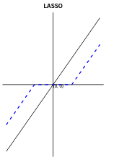
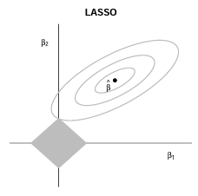

Lasso regression (cont’d)
The intercept term in the regression equation is not shrunken
The lasso solutions are not equivalent under scaling of the regressors $⇒$ one normally standardizes the regressors before analysis
The solution cannot be given in closed form, but efficient algorithms exist to compute the entire path of solutions as $λ$ is varied
The entire path for all $λ$ values can be determined in a computationally efficient way using a similar algorithm as least angle regression (LAR)
Lasso Regression: https://www.statisticshowto.com/lasso-regression/
https://statweb.stanford.edu/~jtaylo/courses/stats203/notes/penalized.pdf

Slide 13
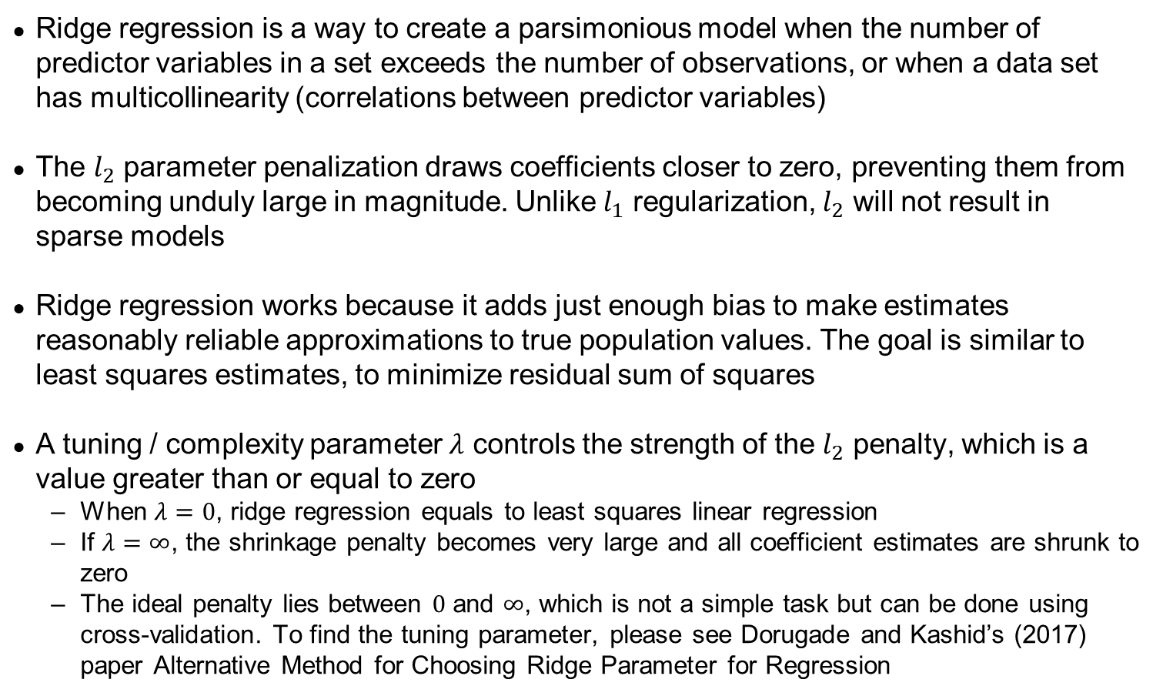
Ridge regression
Ridge regression is a way to create a parsimonious model when the number of predictor variables in a set exceeds the number of observations, or when a data set has multicollinearity (correlations between predictor variables)
The $l_{2}$ parameter penalization draws coefficients closer to zero, preventing them from becoming unduly large in magnitude. Unlike $l_{1}$ regularization, $l_{2}$ will not result in sparse models
Ridge regression works because it adds just enough bias to make estimates reasonably reliable approximations to true population values. The goal is similar to least squares estimates, to minimize residual sum of squares
A tuning / complexity parameter $λ$ controls the strength of the $l_{2}$ penalty, which is a value greater than or equal to zero
When $λ=0$, ridge regression equals to least squares linear regression
If $λ=∞$, the shrinkage penalty becomes very large and all coefficient estimates are shrunk to zero
The ideal penalty lies between $0$ and $∞$, which is not a simple task but can be done using cross-validation. To find the tuning parameter, please see Dorugade and Kashid’s (2017) paper Alternative Method for Choosing Ridge Parameter for Regression
Ridge Regression: https://www.statisticshowto.com/ridge-regression/
Dorugade and D. N. Kashid. Alternative Method for Choosing Ridge Parameter for Regression. Applied Mathematical Sciences, Vol. 4, 2010, no. 9, 447 – 456. Retrieved July 29, 2017 from: http://www.m-hikari.com/ams/ams-2010/ams-9-12-2010/dorugadeAMS9-12-2010.pdf.

Slide 14
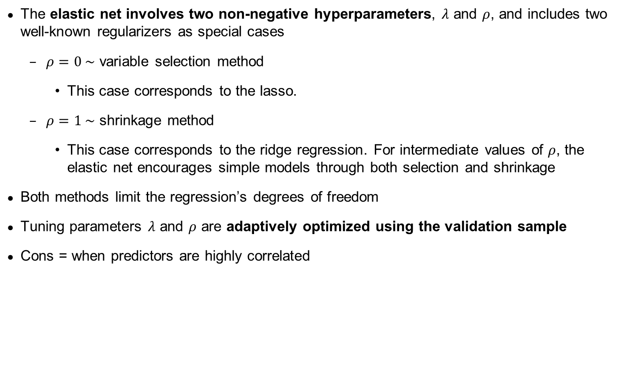
Elastic net regression
The elastic net involves two non-negative hyperparameters, $λ$ and $ρ$, and includes two well-known regularizers as special cases
$ρ=0 \sim$ variable selection method
This case corresponds to the lasso.
$ρ=1 \sim$ shrinkage method
This case corresponds to the ridge regression. For intermediate values of $ρ$, the elastic net encourages simple models through both selection and shrinkage
Both methods limit the regression’s degrees of freedom
Tuning parameters $λ$ and $ρ$ are adaptively optimized using the validation sample
Cons = when predictors are highly correlated
Regularization and Shrinkage.

Slide 15
Sample splitting: Training, validation, and testing
Training subsample
Validation subsample
Testing subsample
Tune hyperparameters
Construct forecasts for data points
Calculate objective function based on forecast errors from validation sample
Evaluate using lowest MSE
Simulate OOS test of the model
E.g. compare outcomes of various algorithms, and choose the one with the best performance. 20% of sample
Evaluate method’s predictive performance with best / optimal parameters
E.g. 20% of sample on the chosen prediction algorithm
Estimate the model subject to a specific set of tuning parameters values
e.g., multiple algorithms or model candidates, 60% of sample
Models that have no hyperparameters or those that do not have tuning options typically do not need a validation set.
If you already have a model in mind with all its parameterizations, you don’t need a validation set.

Slide 16
Choice of Hyperparameters
Penalization parameters (in lasso and elastic net)
Number of iterated trees in boosting
The number of random trees in a forest
The depth of the trees
The number of hidden layers and nodes in neural networks

Slide 17
Applying linear learning to return prediction and portfolio construction, an example
Step 1- Fit and train the model via training and/or validation sets. Predict returns with the learning set.
Evaluate the OOS performance of the model
Step 2- Based on Machine Learning assisted return prediction, construct a portfolio, for example, construct an equal-weighted portfolio that:
Buys the top 10 percent of stocks with the highest predicted return
Short sells the bottom 10 percent of stocks with the lowest predicted return
Step 3: Evaluate the performance of the portfolio.

Slide 18
Linear Prediction with Dimension Reduction
The idea of predictor averaging is the essence of dimension reduction.
Reduces noise to better isolate the signal in predictors
Helps de-correlate otherwise highly dependent predictors
Two classic dimension reduction techniques:
Principal components regression (PCR)
Partial least squares (PLS)
PLS is most suitable for forecasting returns as it performs direction reduction by directly exploiting covariation of predictors with the forecast target.

Slide 19
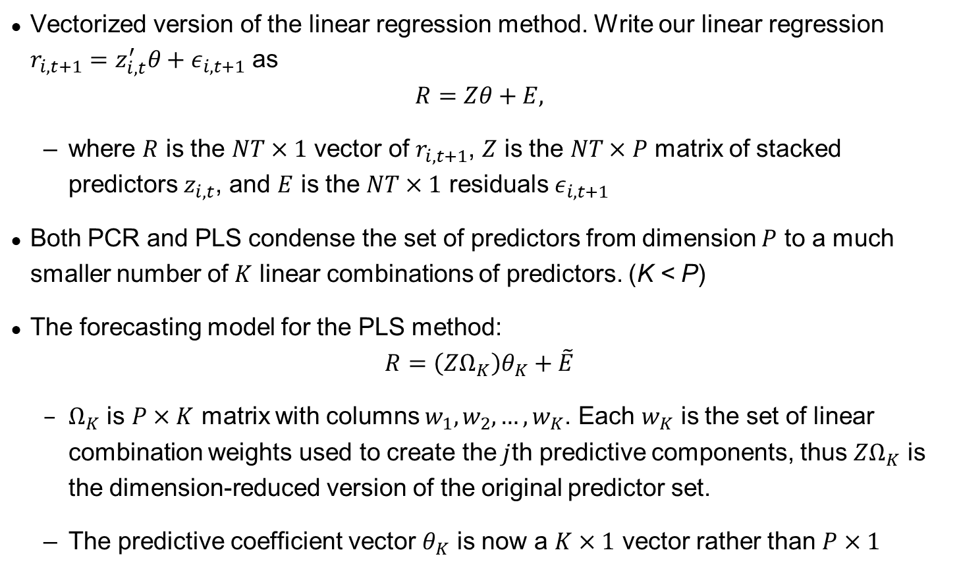
Linear Prediction with Dimension Reduction
Vectorized version of the linear regression method. Write our linear regression $r_{i,t+1}=z_{i,t}^{′}θ+ε_{i,t+1}$ as
$$R=Zθ+E,$$
where $R$ is the $NT×1$ vector of $r_{i,t+1}$, $Z$ is the $NT×P$ matrix of stacked predictors $z_{i,t}$, and $E$ is the $NT×1$ residuals $ε_{i,t+1}$
Both PCR and PLS condense the set of predictors from dimension $P$ to a much smaller number of $K$ linear combinations of predictors. (K < P)
The forecasting model for the PLS method:
$$R=\left(ZΩ_{K}\right)θ_{K}+\tilde{E}$$
$Ω_{K}$ is $P×K$ matrix with columns $w_{1},w_{2},…,w_{K}$. Each $w_{K}$ is the set of linear combination weights used to create the$j$th predictive components, thus $ZΩ_{K}$ is the dimension-reduced version of the original predictor set.
The predictive coefficient vector $θ_{K}$ is now a $K×1$ vector rather than $P×1$

Slide 20
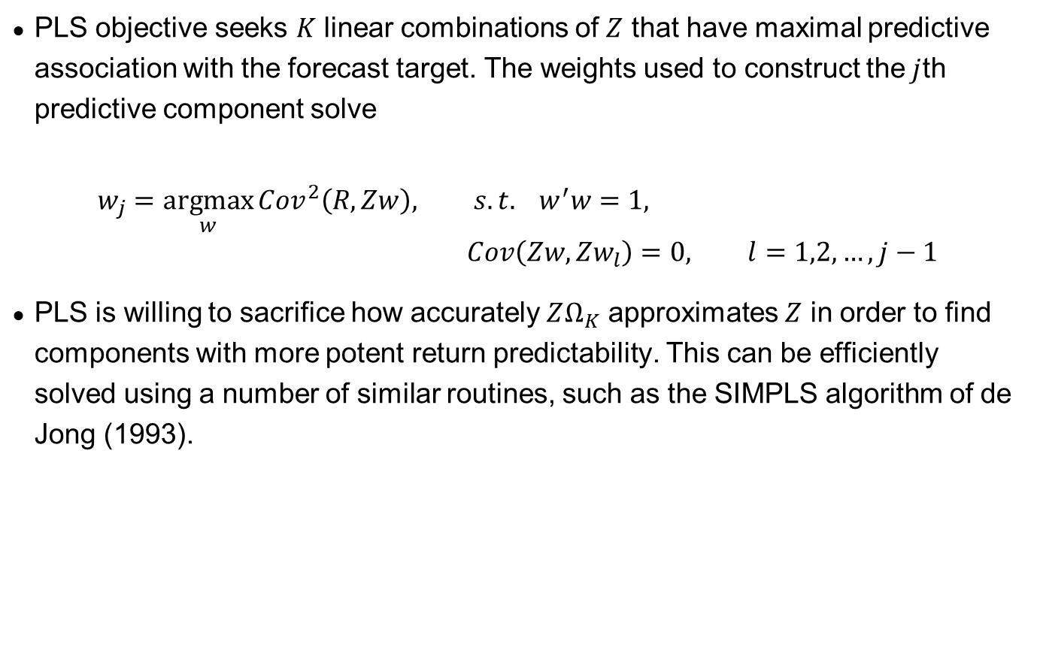
Linear Prediction with Dimension Reduction
PLS objective seeks $K$ linear combinations of $Z$ that have maximal predictive association with the forecast target. The weights used to construct the$j$th predictive component solve
$$w_{j}=\underset{w}{argmax}{{Cov}^{2}\left(R,Zw\right), s.t. } w^{′}w=1, Cov\left(Zw,{Zw}_{l}\right)=0, l=1,2,…,j−1$$
PLS is willing to sacrifice how accurately $ZΩ_{K}$ approximates $Z$ in order to find components with more potent return predictability. This can be efficiently solved using a number of similar routines, such as the SIMPLS algorithm of de Jong (1993).
PLS: See notes by Adbi of UT-Dallas https://www.utdallas.edu/~herve/Abdi-PLS-pretty.pdf

Slide 21
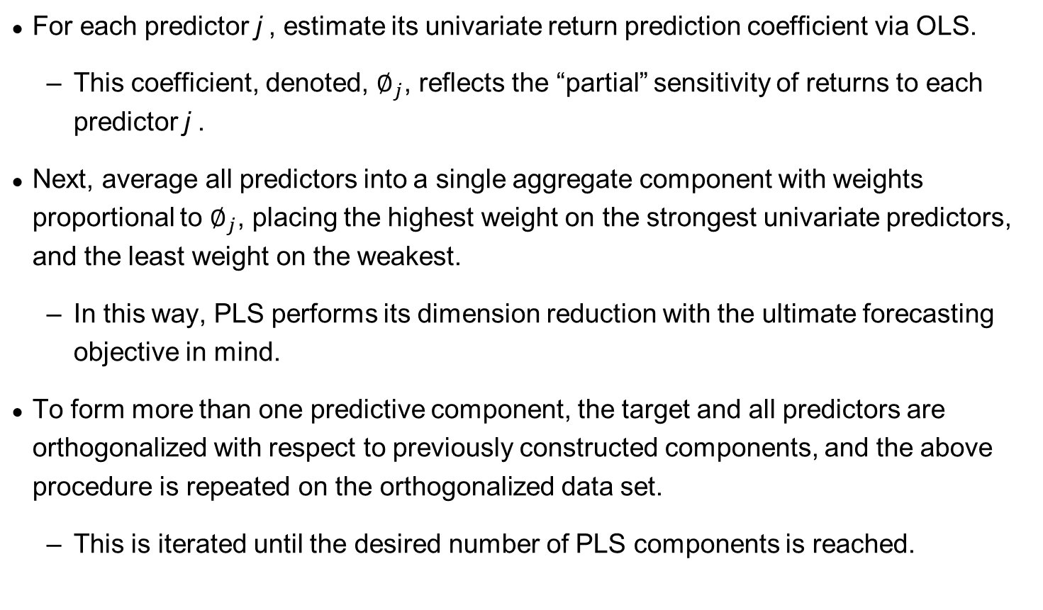
PLS in words
For each predictor j , estimate its univariate return prediction coefficient via OLS.
This coefficient, denoted, $∅_{j}$, reflects the “partial” sensitivity of returns to each predictor j .
Next, average all predictors into a single aggregate component with weights proportional to $∅_{j}$, placing the highest weight on the strongest univariate predictors, and the least weight on the weakest.
In this way, PLS performs its dimension reduction with the ultimate forecasting objective in mind.
To form more than one predictive component, the target and all predictors are orthogonalized with respect to previously constructed components, and the above procedure is repeated on the orthogonalized data set.
This is iterated until the desired number of PLS components is reached.

Slide 22

Exercise
On the testing sample from ML Lecture 1, evaluate the impact of the 2 elastic net parameters and PLS on out-of-sample performance accuracy vs. linear regression in terms predictive $R^{2}$ for the monthly stock-level panel and the Sharpe ratios long-short portfolio’s monthly decile spread (OR mean, standard deviation, and Sharpe ratio of long-short portfolio’s monthly returns) with equal-weight and value-weight formation.

